Slide 1
Chapter 3: Process Concept
Ridwan Kabir

Slide 2
Chapter 3: Process Concept
Process Concept
Process Scheduling
Cooperating Processes
Interprocess Communication

Slide 3
Process Concept
An operating system executes a variety of programs:
  Batch system – jobs
  Time-shared systems – user programs or tasks
Textbook uses the terms job and process almost interchangeably
Process – a program in execution; process execution must progress in sequential fashion
A process includes:
  program counter
  stack
  data section
  heap
Notes:
Stack – temporary data, parameters, return address, local variable
Heap – dynamically allocated variable
Data section – global variable

Slide 4
Process State
As a process executes, it changes state
  new: The process is being created
  running: Instructions are being executed
  waiting: The process is waiting for some event to occur
  ready: The process is waiting to be assigned to a processor
  terminated: The process has finished execution

Slide 5

Diagram of Process State

Slide 6
Process Control Block (PCB)
Information associated with each process
Process state
Program counter
CPU registers
CPU scheduling information
Memory-management information
Accounting information
I/O status information

Slide 7

Process Control Block (PCB)

Slide 8
Context Switch
When CPU switches to another process, the system must save the state of the old process and load the saved state for the new process
Context-switch time is overhead; the system does no useful work while switching
Time dependent on hardware support

Slide 9

CPU Switch From Process to Process

Slide 10
Schedulers
Long-term scheduler (or job scheduler) – selects which processes should be brought into the ready queue
Short-term scheduler (or CPU scheduler) – selects which process should be executed next and allocates CPU

Slide 11
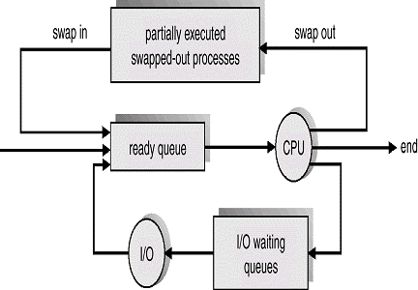
Mid-term scheduler
sometime it can be advantageous to remove process from the memory and thus to reduce the degree of multi-programming.

Slide 12
Schedulers (Cont.)
Short-term scheduler is invoked very frequently (milliseconds) ⇒ (must be fast)
Long-term scheduler is invoked very infrequently (seconds, minutes) ⇒ (may be slow)
The long-term scheduler controls the degree of multiprogramming
Processes can be described as either:
  I/O-bound process – spends more time doing I/O than computations.
  CPU-bound process – spends more time doing computations.
Notes:
All I/O bound → ready queue empty
All CPU bound → I/O queue empty

Slide 13
Process Scheduling Queues
Maximize CPU use, quickly switch processes onto CPU for time sharing.
Process scheduler selects among available processes for next execution CPU.
Maintains scheduling queues of process.
Job queue – set of all processes in the system
Ready queue – set of all processes residing in main memory, ready and waiting to execute
Device queues – set of processes waiting for an I/O device
Processes migrate among the various queues

Slide 14

(Queueing-Diagram)
Representation of Process Scheduling

Slide 15
Process Creation
Parent process creates children processes, which, in turn create other processes, forming a tree of processes
Resource sharing options:
  Parent and children share all resources
  Children share subset of parent’s resources
  Parent and child share no resources
Execution options:
  Parent and children execute concurrently
  Parent waits until children terminate

Slide 16
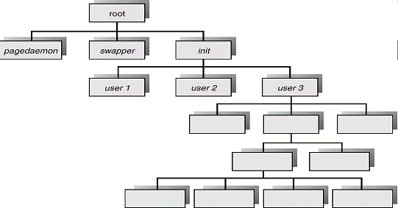
Processes Tree on a UNIX System

Slide 17
Cooperating Processes
Independent process cannot affect or be affected by the execution of another process
Cooperating process can affect or be affected by the execution of another process
Advantages of process cooperation
  Information sharing
  Computation speed-up
  Modularity
  Convenience

Slide 18
Interprocess Communication
Processes within a system may be independent or cooperating
Cooperating process can affect or be affected by other processes, including sharing data, Information sharing.
Cooperating processes need interprocess communication (IPC)
  IPC provides a mechanism to allow processes to communicate and to synchronize there actions.
Two models of IPC
  Shared memory
  Message passing

Slide 19

Interprocess Communication (IPC) Models
a) Message Passing b) Shared Memory
Notes:
Shared memory – faster; good for large data; must be in the same machine
Message passing – good for processes running on different machines in a network; good for smaller data
The kernel is → the central module of an Operating System (OS)
→ It is the part of the operating system that loads first, and it remains in main memory.
→ It is important for the kernel to be as small as possible while still providing all the essential services required by other parts of the operating system and applications.

Slide 20
Shared-Memory
Establish a region of shared memory
Read and write data in the shared area
Processes responsible for synchronization
  Must ensure that same memory location is not being modified by multiple processes at the same time

Slide 21
Message-Passing systems
Mechanism for processes to communicate and to synchronize their actions
Message system – processes communicate with each other without resorting to shared variables
IPC facility provides two operations:
  send(message) – message size fixed or variable
  receive(message)
If P and Q wish to communicate, they need to:
  establish a communication link between them
  exchange messages via send/receive

Slide 22
End of Chapter 4

